Slide 1




Society of Psychophysiological Research (SPR), 63rd Annual Meeting, New Orleans, LA, September 27 - October 1, 2017
Targeting mechanisms of emotion regulation during CBT in depression:
Preliminary findings linking mindfulness, treatment response,
and ERPs to emotionally-arousing stimuli
Jürgen Kayser, Yifan Gao, Tayler Wilson, Rocco Rinaldo-Rose,
Chris Aceto, Steven D. Hollon, Gerard E. Bruder, Ronit Kishon
New York State Psychiatric Institute & Columbia University
Psychophysiological Laboratory

Slide 2
Background
Dysfunctions in emotion processing and regulation (ER) are a core deficit of mood disorders
Involves abnormal activations of specific brain regions critical for ER and self-awareness
Key modules for emotion processing/regulation and self-awareness
Tang Y-Y, et al 2015 Nat Rev Neurosci 16:213-225
Activity in these brain regions is modulated by prefrontal regions responsible for up- and down-regulation of emotional processes
An improved understanding of these processes will benefit the treatment of mood disorders
In unipolar depression, CBT is effective for ~50% of patients: Identify mechanisms and biomarkers that predict CBT response

Slide 3

Visual Attention and the “Emotional” Brain
Detection of stimulus significance
Circuit for processing the affective components of a visual item
Conscious
critical mechanism for survival
interactions between affective and cognitive processing systems
reaches conscious awareness within the hierarchy of information processing
salience (threat, disgust) prompts additional activations
Parietal
Cortex
PFC
Secondary
Vis Ctx
AI
Amyg
Nonconscious
LeDoux JE 2015 Anxious NY: Penguin Books
Pessoa L 2008 Nat Rev Neurosci 9:148-158
Hemispheres are differentially involved during affective states and affective processing
multiple processing stages:
early visual => prefrontal
visual cortex activation reflecting salience will result in simultaneous bottom-up and top-down modulation from frontoparietal (attention) and emotional (amygdala) regions
Abnormalities in hemispheric function have been associated with mood disorders

Slide 4
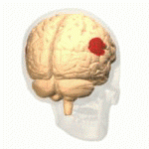
Background
MDD patients show evidence of left anterior and right posterior hypoactivation
neuropsychological test profiles
quantitative EEG studies
functional neuroimaging (SPECT, PET) data
neuropsychological test profiles
behavioral laterality task performance
decreased autonomic responsivity
electrophysiological (EEG/ERP, MEG) data
Cuthbert BN, et al 2000 Biol Psychol 52:95-111
ERPs to emotional stimuli are characterized by
broad, long-lasting late positive potential (LPP)
mid-centroparietal scalp topography
emerges ~200-300 ms after stimulus onset
arousing emotional > nonarousing neutral (RH > LH)
less consistent, affective modulation of earlier ERP components (P1, N1, P2, N2, EPN)
MDD patients show reductions of emotional ERPs (amplitude and asymmetry)
functional deficit involving the right temporoparietal junction (rTPJ)
blunted rTPJ responsivity to affective stimuli as a putative biomarker of treatment success
rTPJ
key region for detecting salience and modulating autonomic arousal

Slide 5
Background and Objective
We developed an emotional hemifield task (EHT) that targets the right temporoparietal and occipital cortex (ventral attention network) involved in bottom-up salience detection
During this task, the LPP is reduced in MDD patients
These emotional ERPs reflect brain activations of the ventral visual pathway during stages of salience processing: right occipitotemporal (212 ms; N2)
bilateral posterior cingulate (385 ms; P3)
bilateral inferior temporal cortex (630 ms; CP)
These emotional effects were reduced in individuals at high family risk for depression or with a lifetime diagnosis of MDD
These neuronal activation patterns are indicative of dysfunctional emotion processing in a frontoparieto-temporal neural network and suggest a possible biomarker of treatment outcome, including CBT
However, although fMRI evidence links conscious ER to CBT success, there are no longitudinal studies of whether clinical response to CBT is likewise associated with normalization of ERPs to motivationally salient stimuli
Objective:
measure ERPs during the EHT in MDD before and after cognitive-behavioral (CBT) or nonspecific-supportive therapy (placebo [PBO])
evaluate if blunted emotional ERPs before treatment predict and/or change with treatment outcome

Slide 6


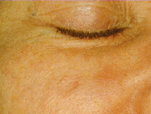

Stimuli
Kayser J, et al 2016 NeuroImage 142: 337-50
Pictures of patients with dermatological diseases (16 negative/neutral pairs before/after cosmetic surgery)
Negative
Facial areas before or during surgical treatment (e.g., a cheek with a melanoma or a wound with stitches)
Neutral
Same facial areas a few years after surgical correction (i.e., healthy skin or a scar)
Scale Mean
Near optimal characterization of the evaluative space for affective stimuli along a Negativity dimension

Slide 7
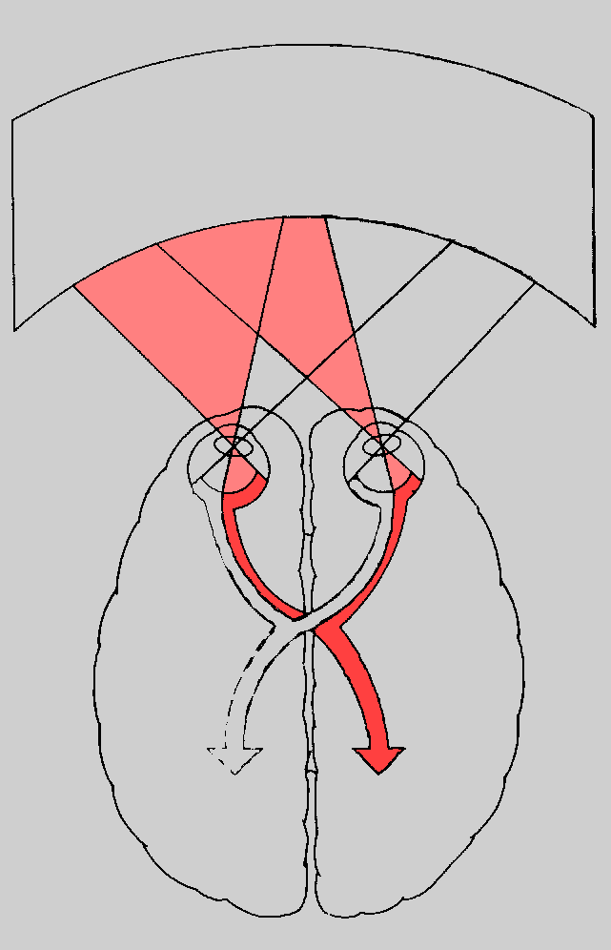
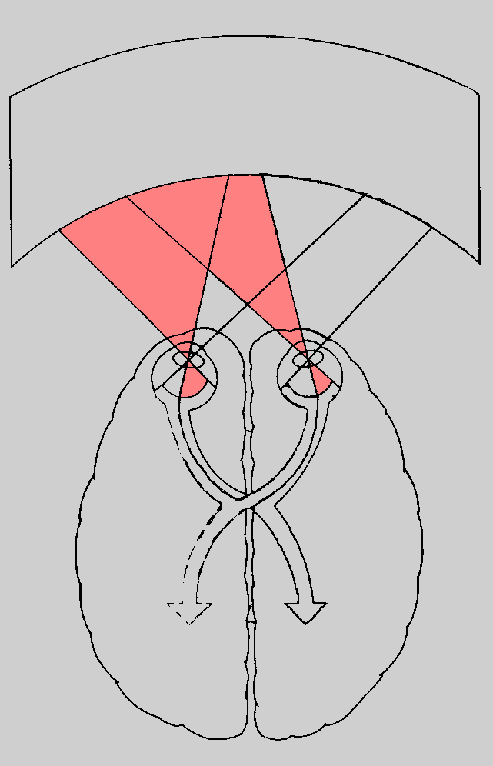
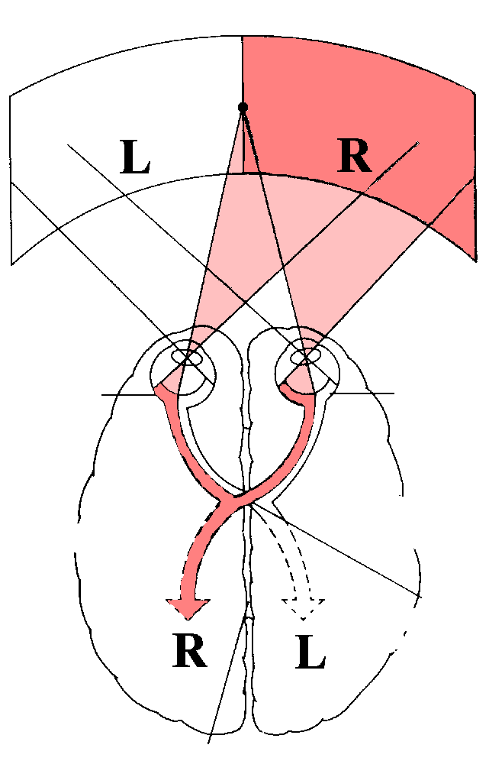
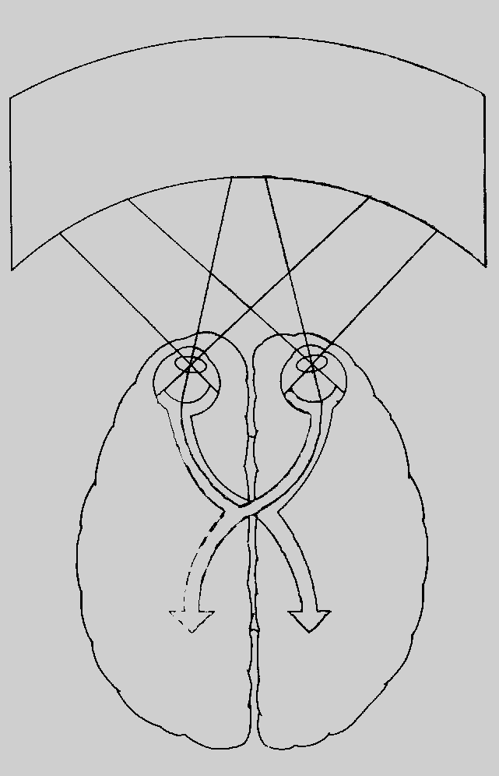

Hemifield Paradigm
Left Visual Field
Right Visual Field
Fixation
Monitoring of saccadic eye movements
Exposure
250 ms
Each stimulus presented to each visual field (128 trials)
Retina
Retina
Pseudo-randomized block sequence
Participants attended to stimuli while maintaining fixation
Left
Hemisphere
Right
Hemisphere
No manual response
Optic
Chiasma
Corpus Callosum

Slide 8
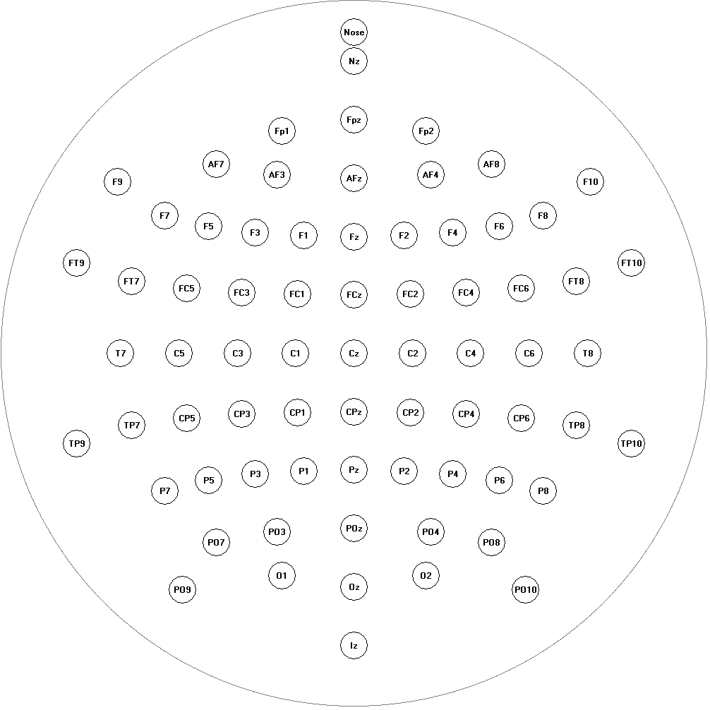

EEG montage, reference and volume conduction
Kayser J, Tenke CE 2015 Int J Psychophysiol 97:189-209
Surface potentials need a reference !
72 channels (10-5 system)
Of any two sites, either site may be the reference …
Laplacian (CSD) Topographies
  Spatial Enhancement technique
  Mathematical transformation (2nd spatial derivative) of EEG
  Removes volume-conducted activity
  Reference-free
  Neuronal generator patterns (sink/source) at scalp
CSD (Poisson’s equation):
  Visual
  Field
  Emotional
  Content

Slide 9
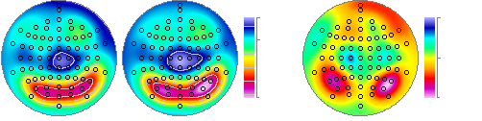
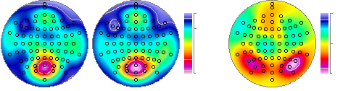
CSD Waveforms and Topographies
Kayser J, et al 2016 NeuroImage 142: 337-50
  Emotional Content Effects
N = 152
Neutral
Negative
Negative - Neutral
-0.08
-0.04
0.0
0.0
+0.22
+0.04
300 ms
-0.07
-0.06
0.0
0.0
P3
source
+0.22
+0.06
LH
RH
490 ms

Slide 10
Temporal PCA
Kayser J, et al 2016 NeuroImage 142: 337-50

Slide 11
Consecutive Stages of Motivated Attention
Kayser J, et al 2016 NeuroImage 142: 337-50
Peak Latency
212 ms
385 ms
630 ms
Distributed Inverse
sLORETA _{max}
right occipito-
temporal cortex
bilateral
PCC
bilateral inferior temporal cortex

Slide 12
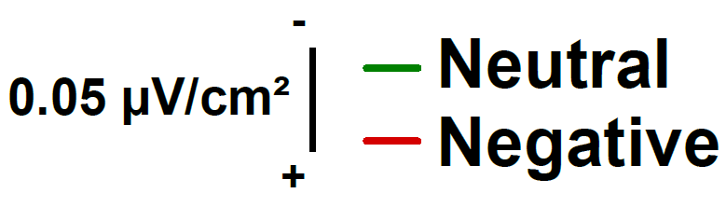
Lifetime Dx for MDD: Blunted Affective Responsivity
Kayser J, et al 2017 NeuroImage: Clin 14: 692-707

Slide 13
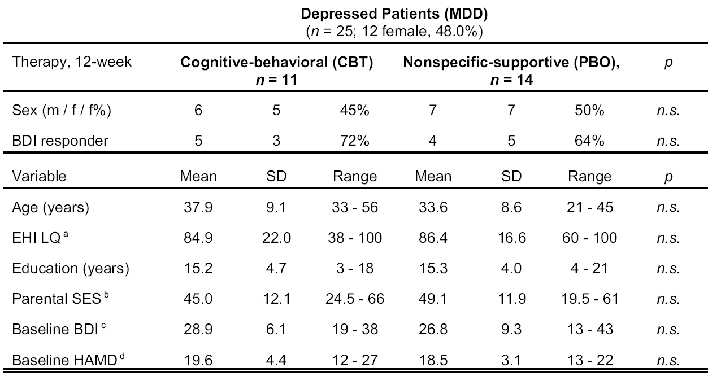
Current Study: Sample
✓
✓

Slide 14
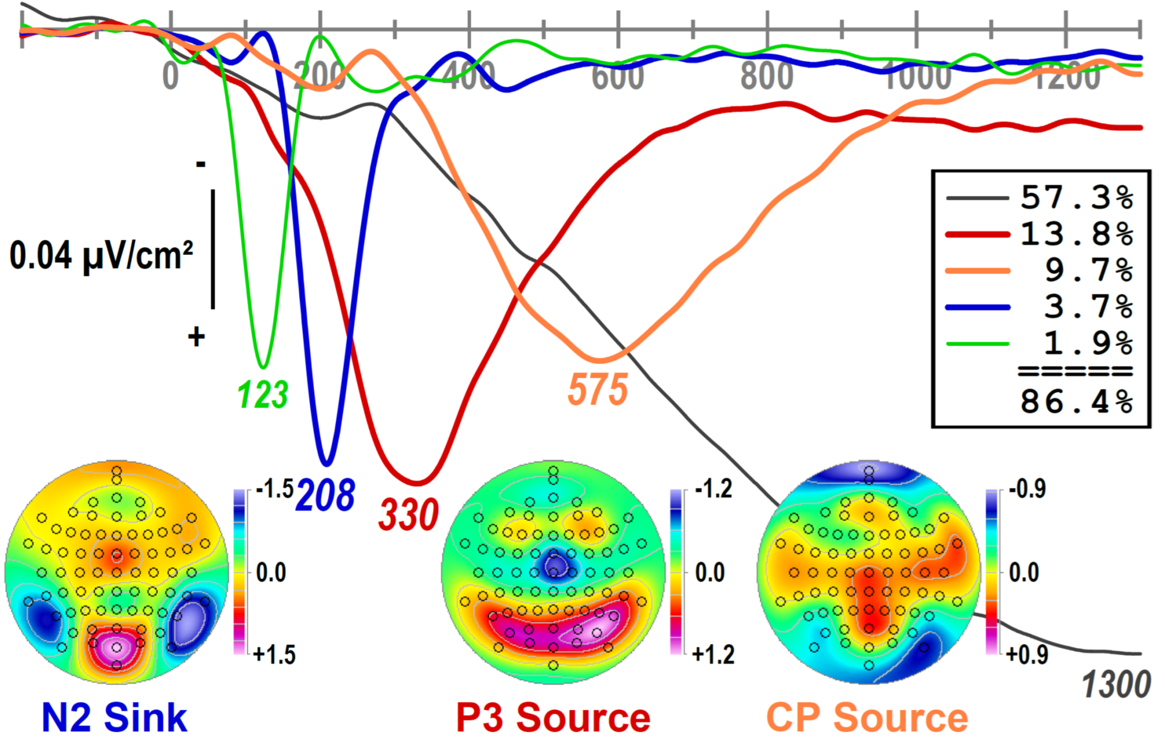
Current Study: Temporal PCA
Targeted components highly comparable (“equality” or “fair similarity”)

Slide 15
Current Study: CSD Waveforms (pooled across pre- and post-Tx)
Non-responders had smaller P3 and LPP than responders

Slide 16
Current Study: Difference Topographies and Randomization Tests
N2 Sink
P3 Source
CP Source
Full Sample
(N = 25)
Responder
(n = 17)
Non-
Responder
(n = 8)

Slide 17
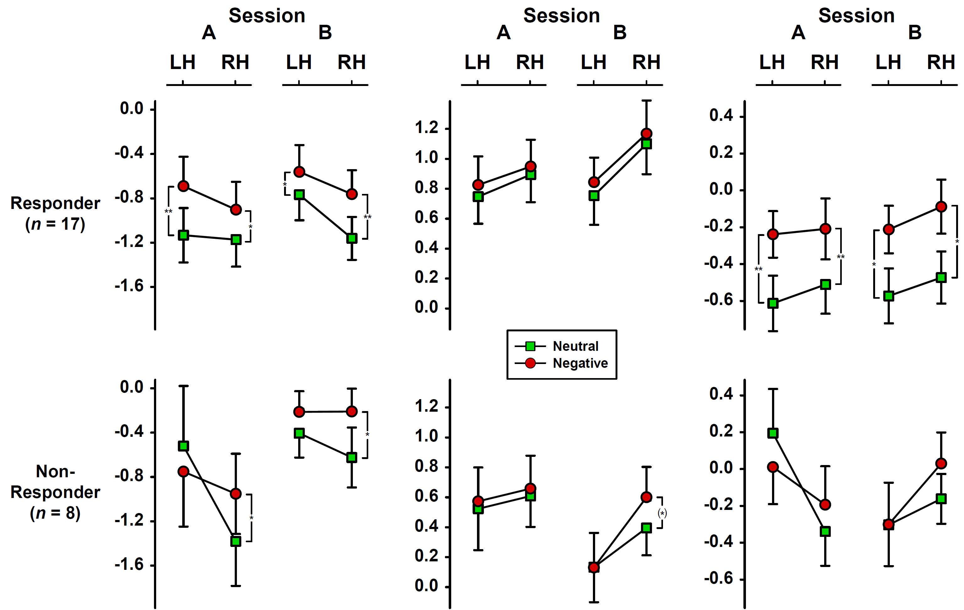
Current Study: Factor Scores over Parietooccipital Regions
N2 Sink
P3 Source
CP Source

Slide 18
Mindful Attention Awareness Scale (MAAS)
Brown & Ryan 2003 J Pers Soc Psychol 4: 822-48
The 15-item MAAS assesses the frequency with which an individual is openly attentive to and aware of present events and experiences using a 6-point Likert scale (‘almost always’ to ‘almost never’). An example item is, ‘I could be experiencing some emotion and not be conscious of it until some time later’. Higher scores indicate higher mindfulness.
Mindfulness modulates LPP
Unpleasant
Brown et al 2013 SCAN 8: 93-9
Brown et al 2013 SCAN 8: 93-9
Additional scales did not reveal a relationship to treatment outcome
Psychological Mindedness:
Mindfulness:
Self-Reflection and Insight Scale (SRIS)
Psychological Mindedness Scale (PMS)
Toronto Alexithymia Scale (TAS)
Five-Facet Mindfulness Questionnaire (FFMQ)
Emotion Regulation Questionnaire (ERQ)
Grant et al 2002 Soc Behav Pers 30: 821-35
Bagby et al 1994 J Psychosom Res 38: 23-32
Conte et al 1996 J Psychother Pract Res 5: 250-9
Baer et al 2006 Assessment 13: 27-45
Gross & John 2003 J Pers Soc Psychol 85: 348-62

Slide 19
Conclusions
Kayser J, et al 2017 NeuroImage: Clin 14: 692-707
Early (preconscious) emotional effects of N2 changed from pre- to post-treatment in responders (from left- to right-lateralized) but not in non-responders (right-lateralized)
There were no emotional content effects of P3 source, consistent with prior findings in MDD
Emotional content effects during the late LPP (CP source) were observed in responders but not non-responders
Symptom improvements were accompanied by increases in (dispositional) mindfulness (MAAS)
This pattern of findings is – in part – consistent with hypothesized differences in top-down regulation of bottom-up emotion processing linked to MDD treatment response
The hierarchical activation of ‘emotional’ brain regions along the occipito-temporal ventral stream (from pre-conscious stimulus categorization to conscious appraisal) is aberrant in non-responders, presumably leading to inhibition of downstream emotional processing
However, considerable caution is warranted: Although treatment groups were matched in clinical and demographic variables, treatment response yielded subgroup differences in age and handedness
An increased sample is required to distinguish placebo response from CBT success
Affective modulation may serve as a somatic marker, signaling salience – a deficit that may be an endophenotype of affective disorders

Slide 20

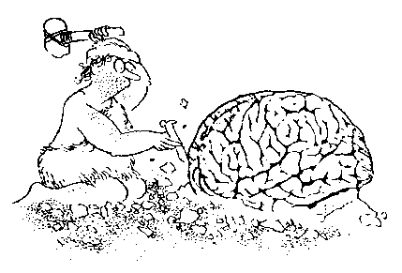
New York State Psychiatric Institute
Psychophysiology Laboratory
http://psychophysiology.cpmc.columbia.edu
Translational Epidemiology
Depression Evaluation Service
Jürgen Kayser
Yifan Gao
Lidia Panier
Jerry Bruder
Ronit Kishon
Tayler Wilson
Rocco Rinaldo-Rose Chris Aceto
Vanderbilt University
Steven Hollon
Funded by: National Institute of Mental Health (MH121915)

